Slide 1

Finite State Automata in Natural Language Processing
COURSE CODE: DSA0305
Guided By: Dr. K. Anbazhagan
Presented By:
V. Venkata Susheel Chowdary
192472060

Slide 2
Introduction
Finite State Automata (FSA) is a mathematical model used to recognize patterns in text.
It is widely used in Natural Language Processing (NLP) for processing words and sentences.
An FSA consists of states, transitions, a start state, and final states.
It is used for tokenization, lexical analysis, and morphological analysis.
It is simple, fast, and efficient, making it useful for many NLP applications.

Slide 3
Objectives
To understand the basics of Finite State Automata (FSA).
To recognize valid patterns in text using FSA.
To implement FSA for simple NLP tasks.
To perform lexical and morphological analysis.
To study the applications of FSA in Natural Language Processing.

Slide 4
Problem Statement
To recognize and validate words or text patterns accurately using predefined rules.
To reduce errors and improve the efficiency of processing natural language input.
To process input strings through a sequence of finite states and transitions.
To support NLP tasks such as lexical analysis, tokenization, and morphological analysis.
To provide a simple and efficient model for recognizing valid language patterns in Natural Language Processing.

Slide 5
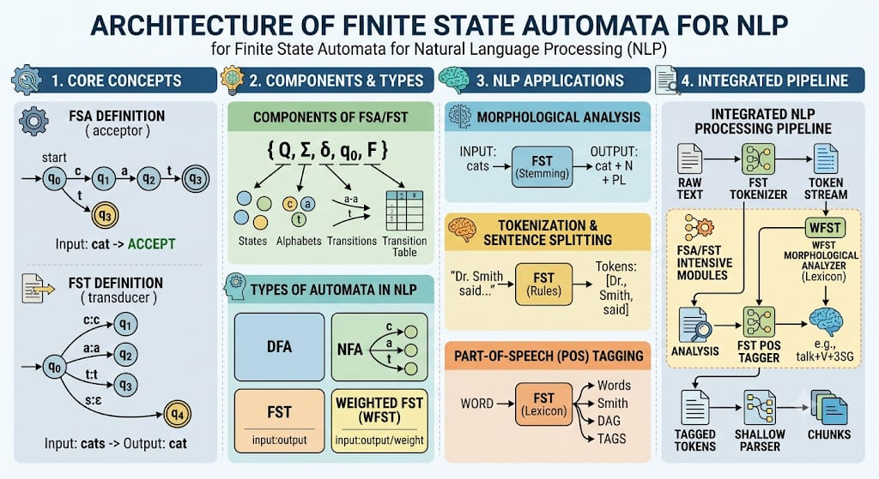

Slide 6
Conclusion
Finite State Automata (FSA) is an effective model for basic NLP tasks.
It accurately recognizes and validates text patterns.
FSA provides fast and efficient text processing.
It supports applications such as tokenization and lexical analysis.
The experiment shows that FSA is a simple and reliable technique for Natural Language Processing.

Slide 7


